Slide 1
Ecommerce Fraud Data
*Extracted from Kaggle

Slide 2
Questions
Exploratory analysis
Patterns
Agenda
Total overview
Fraud and non fraud comparison
Fraud Persona

Slide 3
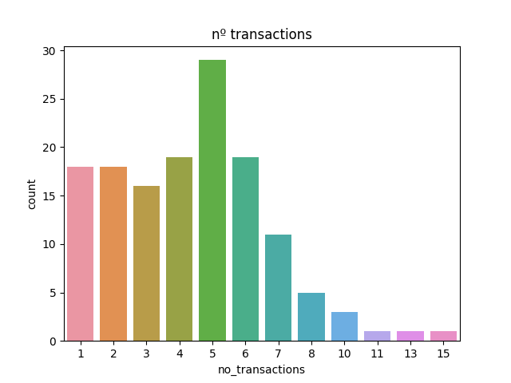
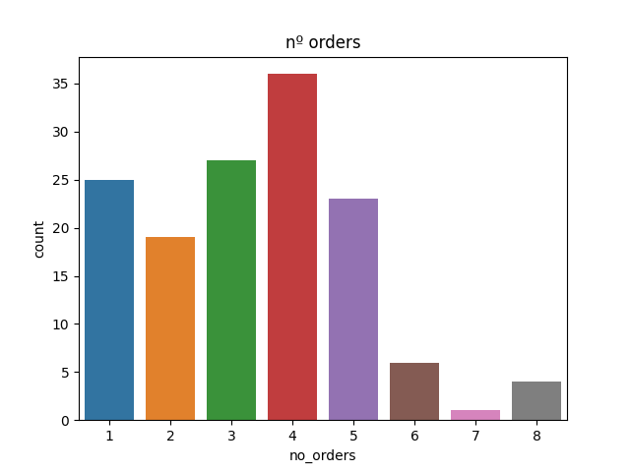
Analysing the total dataset

Slide 4
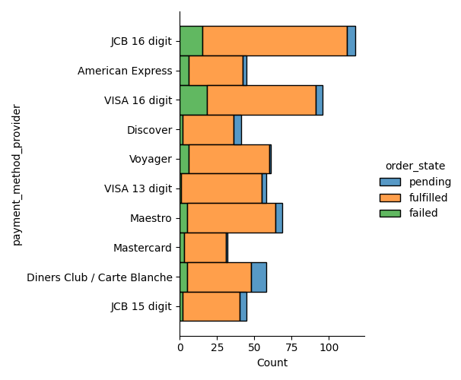
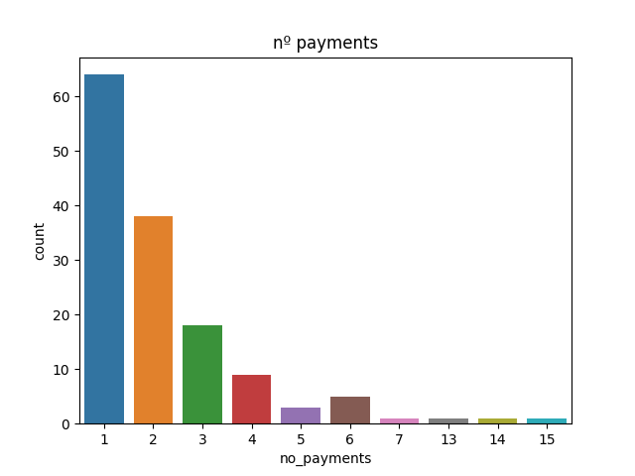
Analysing the total dataset

Slide 5
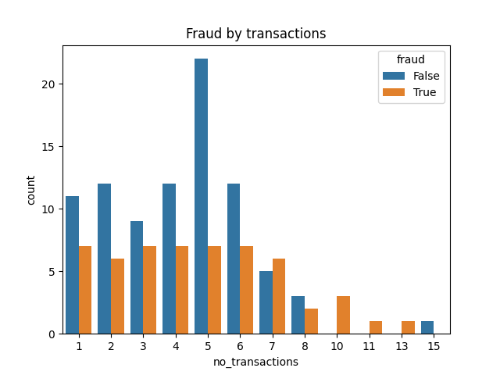
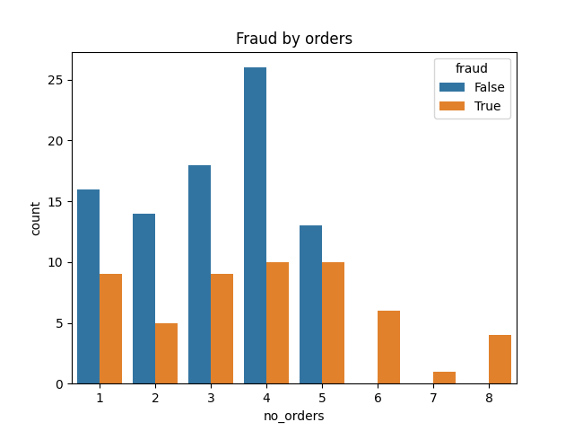
Analysing the total dataset
Above 6 orders are marked as fraud
Same case for high number of transactions

Slide 6
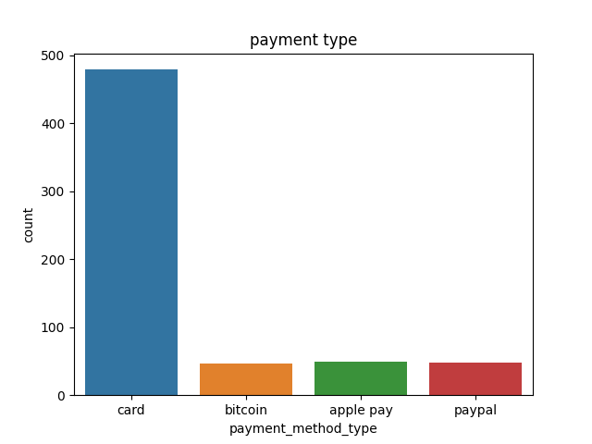
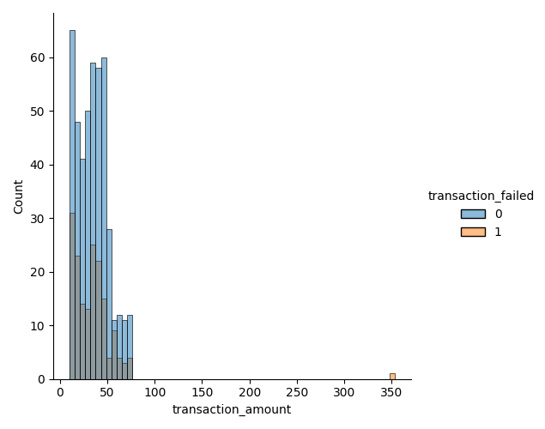
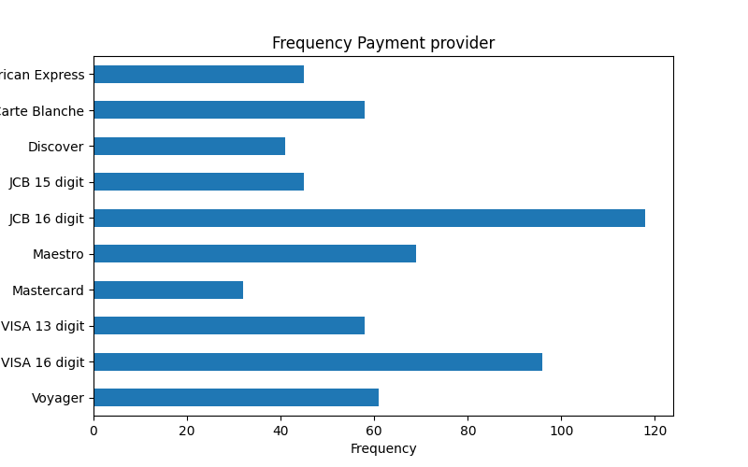
Total dataset

Slide 7
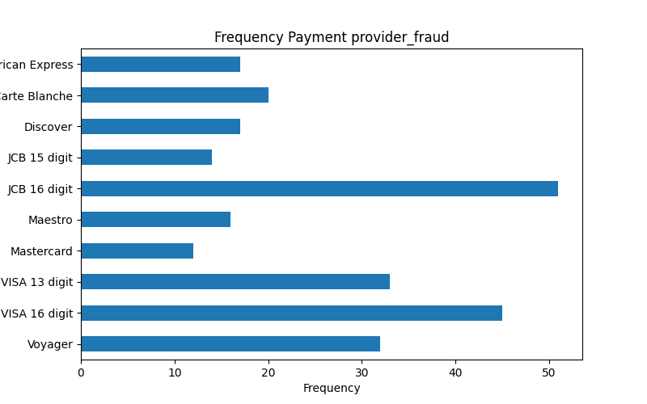
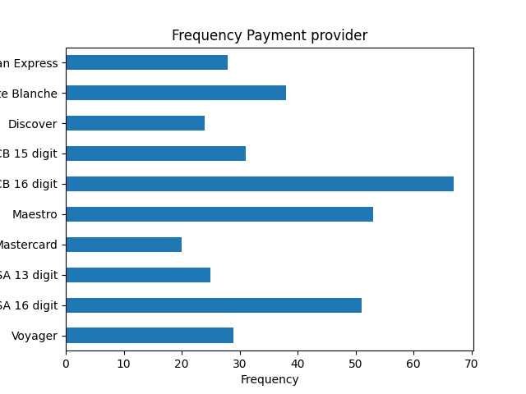
Fraud vs non fraud

Slide 8
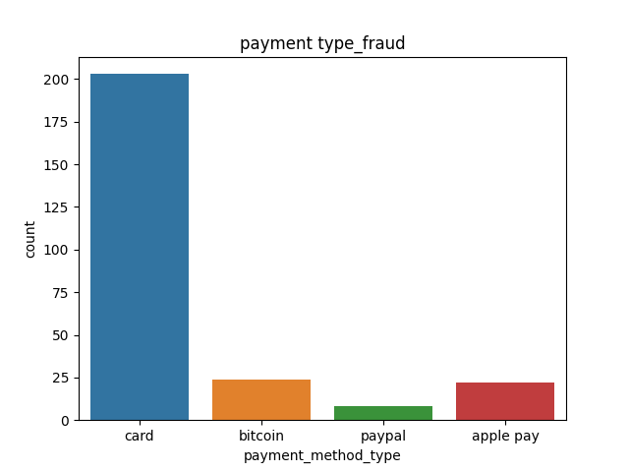
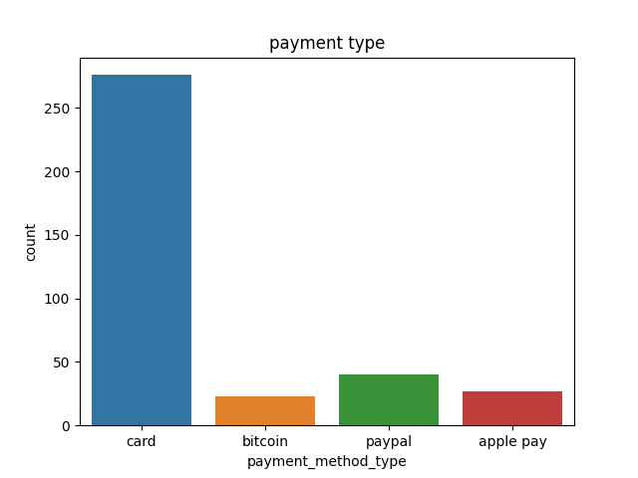
Fraud vs non fraud

Slide 9
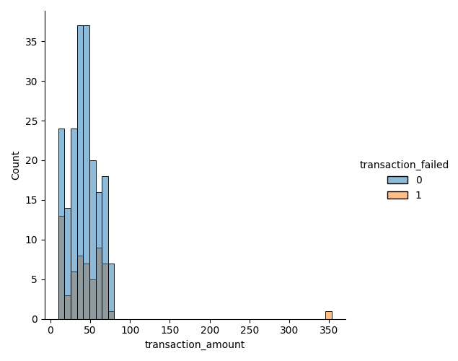
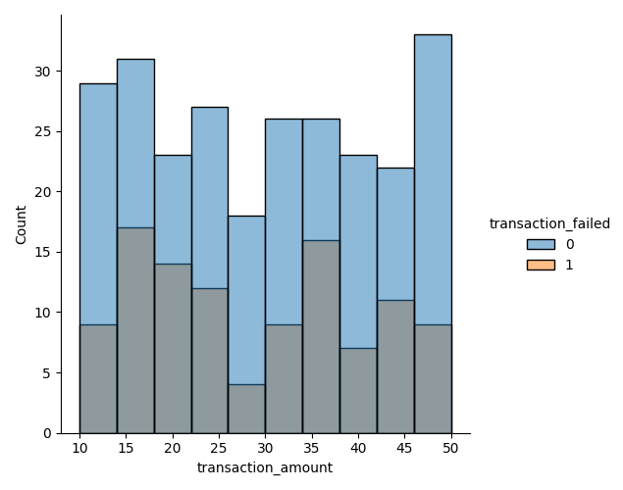
Fraud vs non fraud
The total amount is lower in non fraud cases
The transaction failed in fraud clients are lower

Slide 10
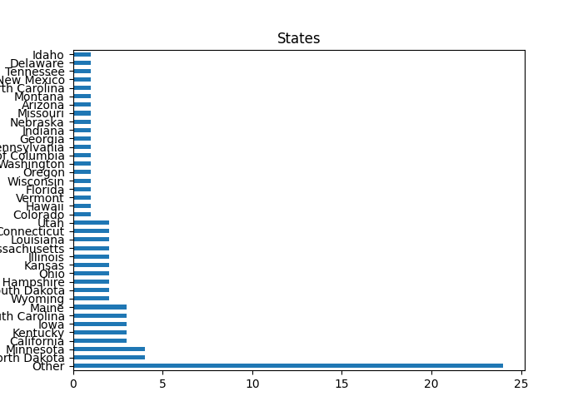
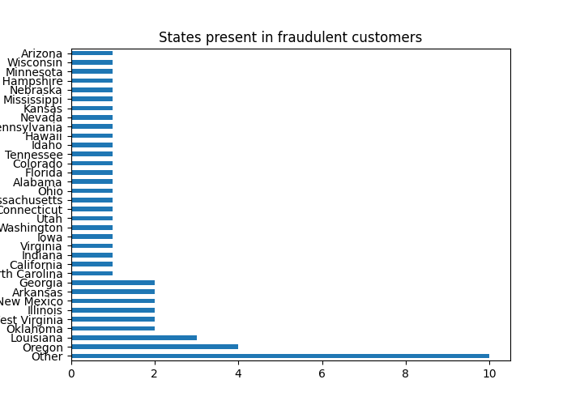
Fraud vs non fraud

Slide 11
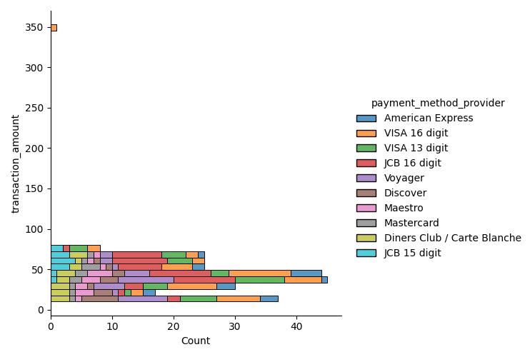
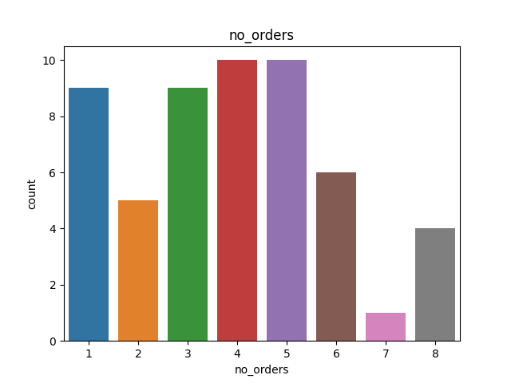
Fraud persona
JCB 16 digit, Visa 16 digit
Number of orders 4/5

Slide 12
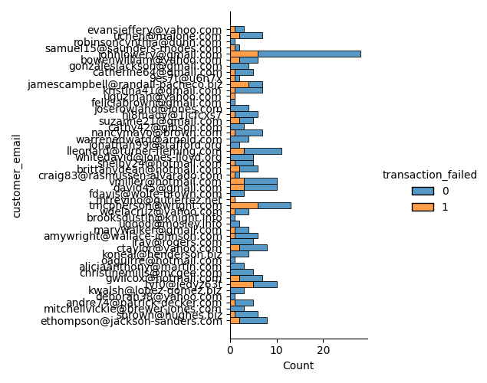
Fraud persona

Slide 13
Conclusion
Dataset is not so big to find many differences between fraud and non fraud clients but we can find some patterns of fraud customers;
Cards, Visa & JCB 16 digit, higher amount and number of orders and low transaction failed;
Next Steps
Statistical model to try to determine some characteristics from fraud clients (number of addresses);

